Slide 1
Christianity in Turkey
By OP

Slide 2
History of Christianity in Turkey
Although, today Turkey acts like almost an Islamic Republic, it is a twist of fate that you can see the first Christian architectural objects in Turkey.
Christianity in Turkey has had a long history dating back to the 1 st century AD.

Slide 3
History of Christianity in Turkey
The earliest Churches had built in west cost of Anatolia (Aegean Sea cost). There are still some churches that you can visit as “museums” or derelict buildings.
The most famous one is in Sirince (Izmir) Church of St. John The Baptist. This church is accepted holy place by Christians.
Today it is a meeting saloon for wine testers and etc. However there are still some frescos that can be seen.

Slide 4
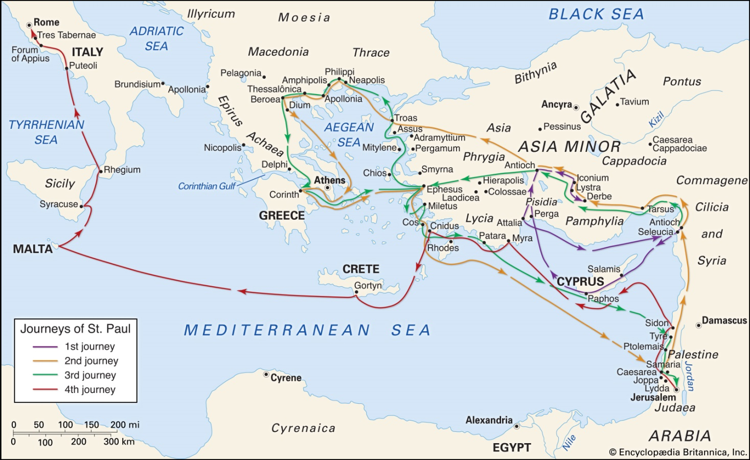
ST. PAUL’S STEPS
During the first two centuries of the Roman Empire,
Paul and his companions sometimes traveled by ship, but much of the time they walked, probably beside a donkey carrying tools, clothes, and perhaps some scrolls.

Slide 5
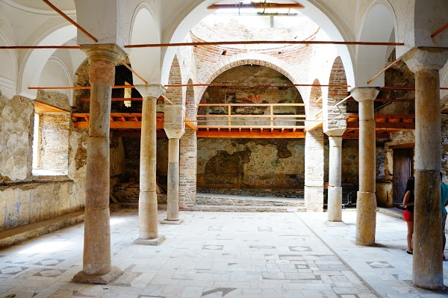
Sirince (Izmir-Smyrna) Church of St. John The Baptist

Slide 6
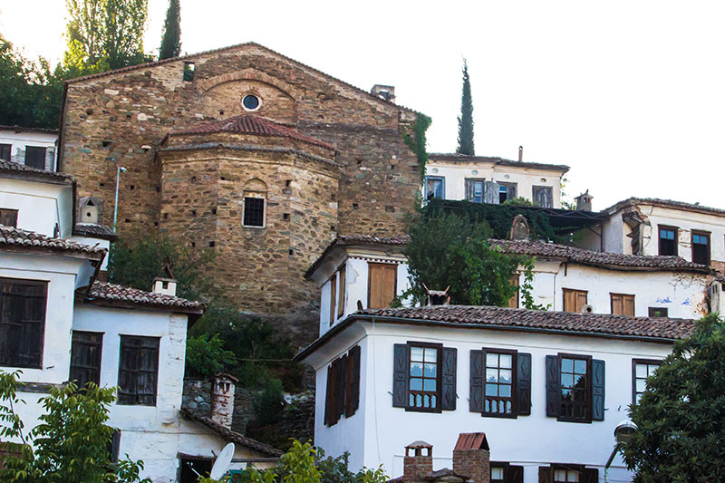
Sirince (Izmir-Smyrna) Church of St. John The Baptist

Slide 7
Cappadocia
Let’s take a look for some more historical places.
Today, Cappadocia is very famous for tourists. It is known that just after Jesus Christ, first Christians were hiding for long years especially at Ihlara Valley
Some of their chapels and underground cities can be seen as touristic purposes.
There are 15 churches but let me show you just some of them:

Slide 8
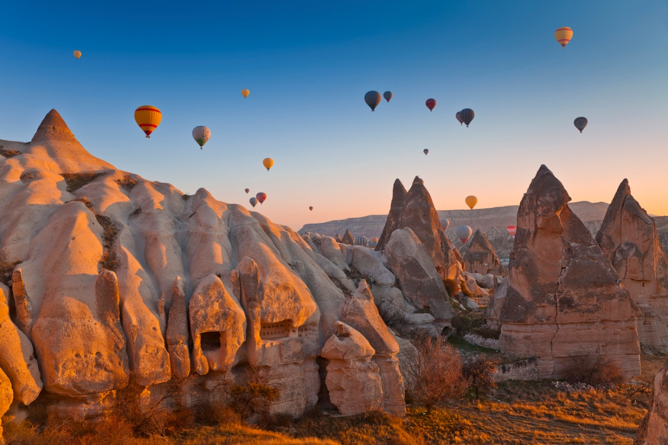
This is the most unique natural environment in Turkey with its magical, fairy like landscape.
Cappadocia

Slide 9
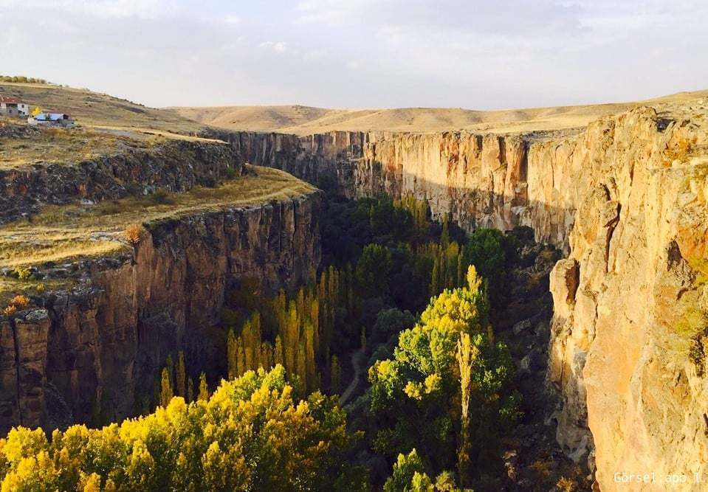
Ihlara Valley in Cappadocia
This valley is full of hidden cave churches.

Slide 10
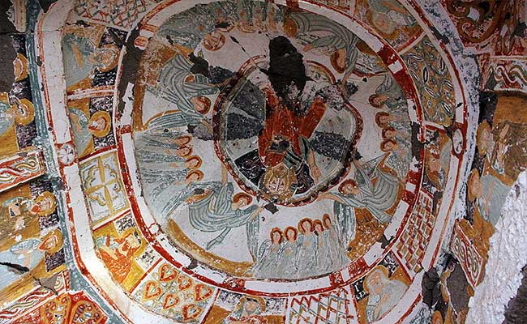
Pantanessa Church in Ihlara Valley in Cappadocia:
Frescos were made with madder.

Slide 11
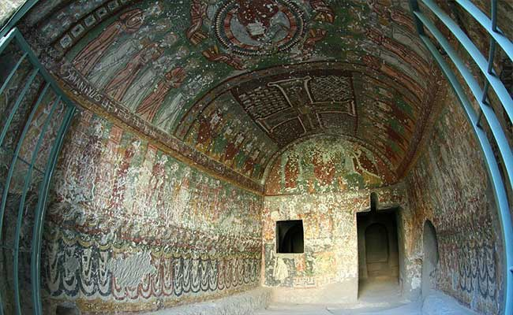
Here the Romans tortured the first Christians.
Religious cave paintings display evidence of early Christianity.
These caves were also used as hiding places from Roman Soliders.

Slide 12
One of the Ancient Civilizations in Anatolia was Armenian Kingdom of Cilicia.
This is the first Christian state in the world (AD. 301).
Byzantine embraced Christianity in 380.
Till 1071, in today’s Turkey country majority was Christian.

Slide 13
Today…
In modern times the percentage of Christians in Turkey has declined
from 20 – 25 percent in 1914
to 3 – 5.5 percent in 1927,
to 0.3 – 0.4% in young ages of republic and today roughly translating
to 90.000 devotees.

Slide 14
Population
Name of Ethnicity | Population
Greek Orthodox | 3.000
Armenians (Armenian Apostolic Church members) | 65.000
Syrian (Syriac Orthodox Church members) | 15.000
Caldian | 3.000
Other Christian Groups | 4.000
Total | 90.000
Turkey’s Population | 84.000.000
Ratio of Christians | 0.10% (NOW)
Christians have lived in Turkey for two millennia – but their future is uncertain

Slide 15
Main Reasons of Decrease
During Ottoman Empire, Christians conscripted with the purpose of joining the janissaries and other Ottoman corps.
Armenian Genocide 1915-1923
Population Exchange 1923
Capital Tax Law (1942)
6-7 September Events (1955)
20 kgs, 20 dollars (1964)
Etc…

Slide 16
Ottoman Christians…
It is known that there are several Christian groups or nations at Ottoman Empire, the most knows are:
Greek Orthodox Christians (Patriarchate of All Greeks)
Armenian Orthodox Christians (Patriarchate of Ottoman Armenians)
Bulgarian Orthodox Christians (Patriarchate of All Bulgarians)
Latin Catholic Christians
Syriac Othodox Christians
Caldian Catholic Christians
Coptic Christians
Greek Catholic Christians
Armenian Catholic Christians

Slide 17
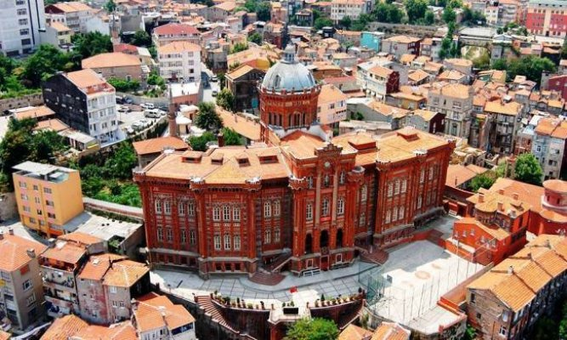
Greek Orthodox Patriarch
(Ecumenical Patriarchate of Constantinople)

Slide 18
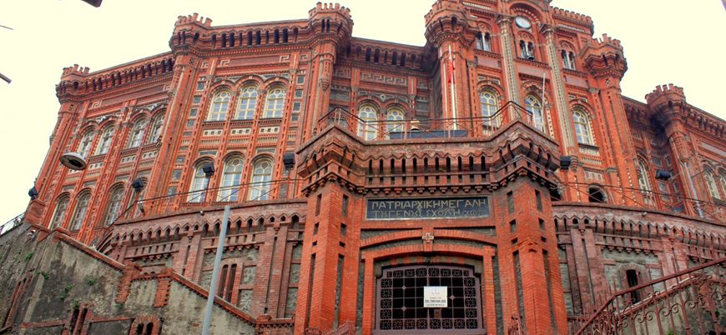
Greek Orthodox Patriarch
(Ecumenical Patriarchate of Constantinople)

Slide 19
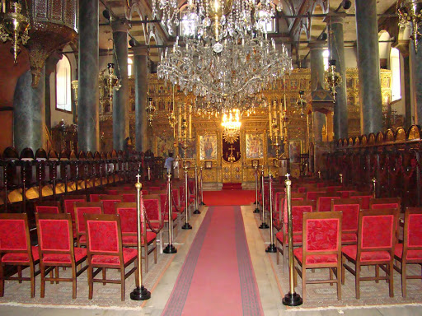
Greek Orthodox Patriarch
(Ecumenical Patriarchate of Constantinople)

Slide 20
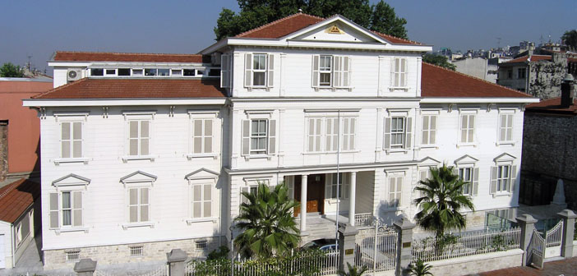
Armenian Patriarchate of Constantinople

Slide 21
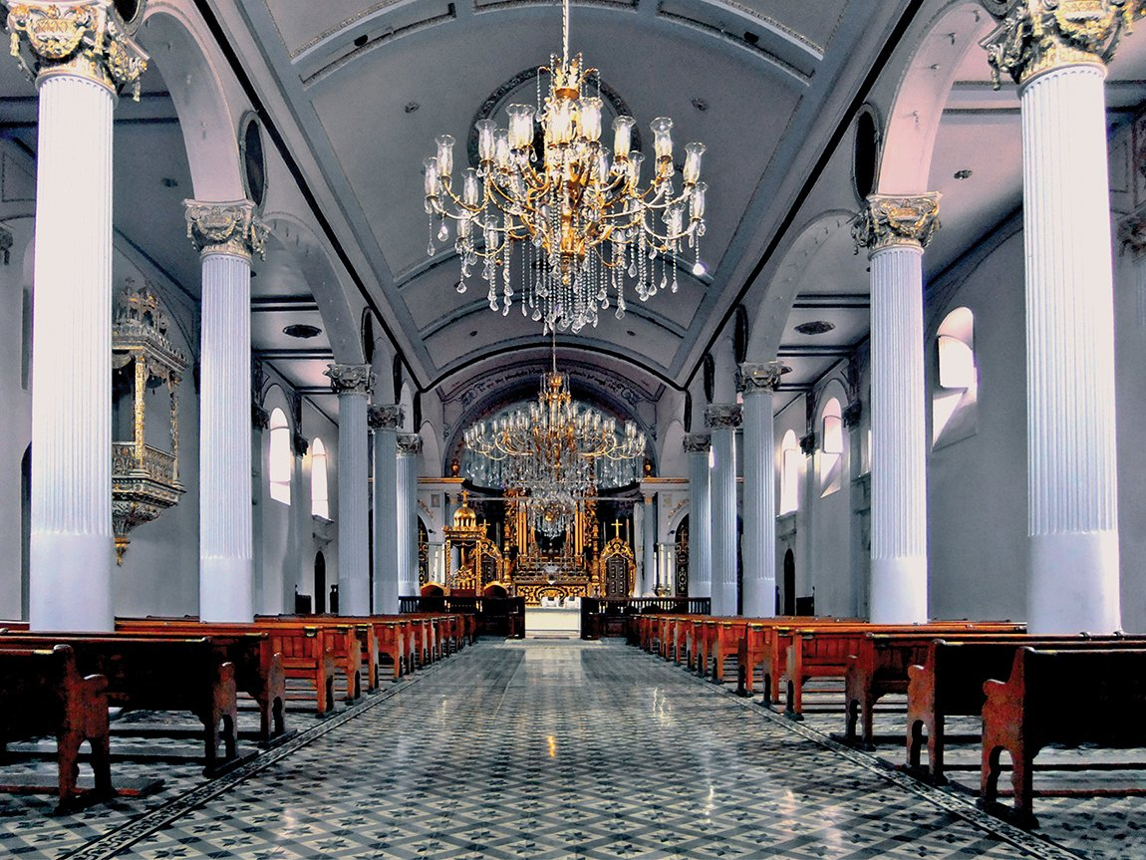
Armenian Patriarchate of Constantinople

Slide 22
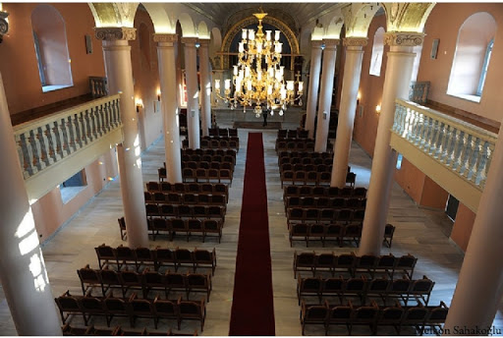
A rebuilt in 2011 (Just next to Patriarchate church, a small chapel Vortvotz Vorodman)

Slide 23
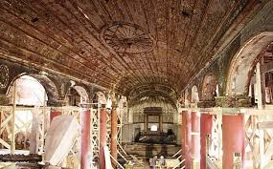
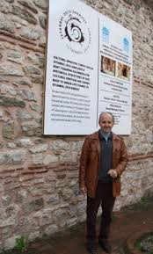
During renovation
Architect of Renovation: Kevork Ozkaragoz

Slide 24
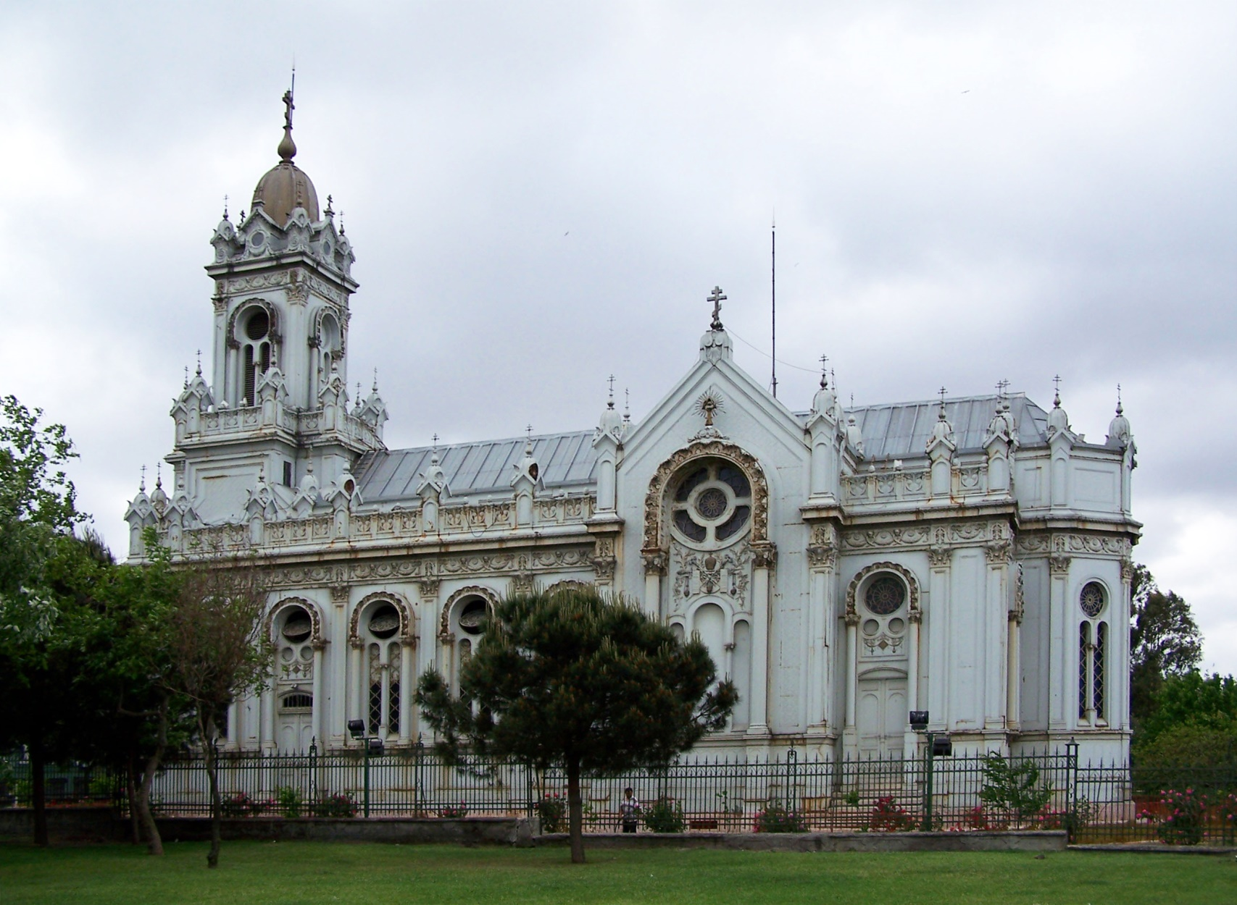
Bulgarian St Stephen Church, also known as the Bulgarian Iron Church, is a Bulgarian Orthodox church in Istanbul, Turkey.
The church belongs to the Bulgarian minority in the city.

Slide 25

Bulgarian St. Stephen Church
This church has an interesting history. In 1893 Bulgar community in Istanbul requested to build a church from Sultan. Sultan did not want a new church in Istanbul however he did not say “no” directly. He had just ordered that, if they could built a church in one day, than they could have it.
According to this order, church pieces had been built in Vienna by iron, and transported to Istanbul (1896). In short, they installed the church in one day in Istanbul.

Slide 26
Genocide
The Armenian Genocide was the systematic mass murder and expulsion of 1.5 million ethnic Armenians carried out in Turkey and adjoining regions by the Ottoman government between 1914 and 1923.
This is a long topic, maybe a topic for another presentation. Just want to inform the reason of decrease in number of Christians.

Slide 27
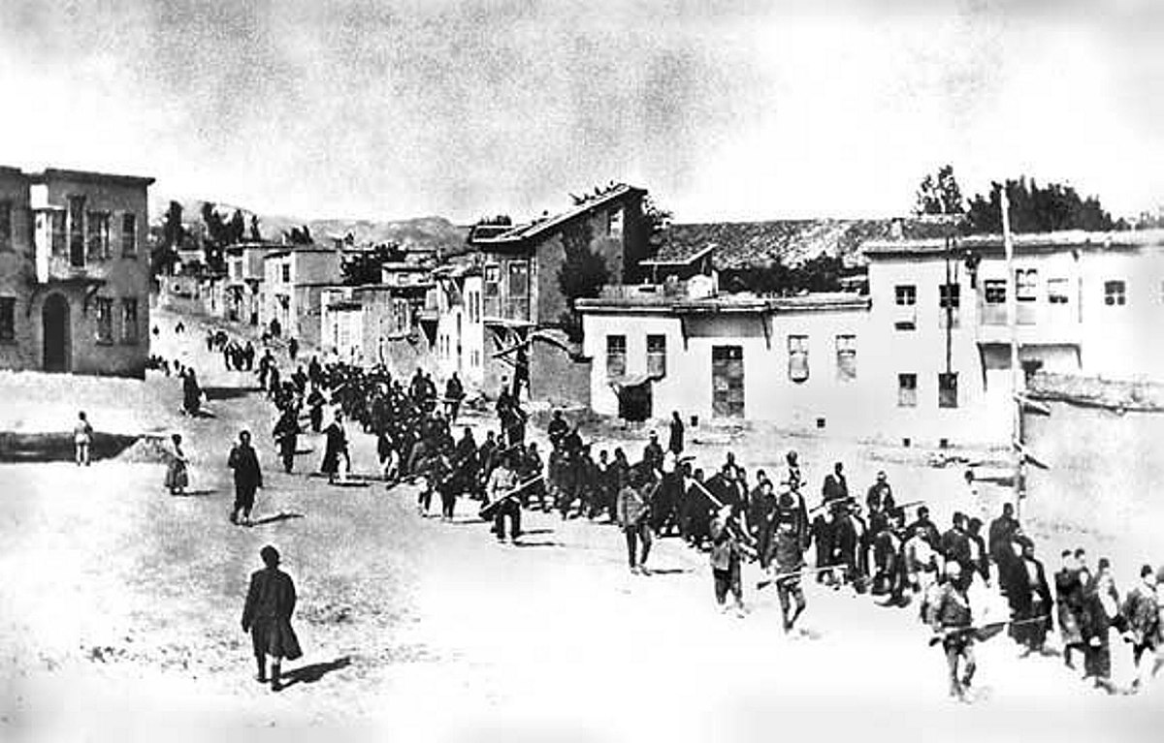
Armenians carried out in Turkey and adjoining regions
by the Ottoman government between 1914 and 1923

Slide 28
Population Exchange
The 1923 population exchange between Greece and Turkey stemmed from the "Convention Concerning the Exchange of Greek and Turkish Populations" signed at Lausanne, Switzerland, on 30 January 1923, by the governments of Greece and Turkey.

Slide 29
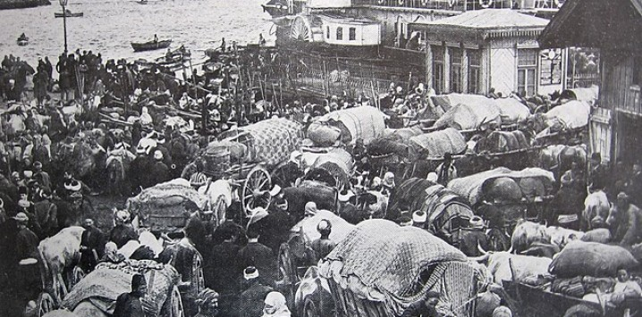
Exchange of Greek and Turkish Populations

Slide 30
Taxes
The bill for the one-off tax was proposed by the government, and the act was adopted by the Turkish parliament on November 1942. It was imposed on the fixed assets, such as landed estates, building owners, real estate brokers, businesses, and industrial enterprises of all citizens, but especially targeted the minorities. Those who suffered most severely were non-Muslims like the Jews, Greeks, Armenians, and Levantines, who controlled a large portion of the economy, though it was the Armenians who were most heavily taxed.
The Tax “Varlık Vergisi” resulted in a number of suicides of ethnic minority citizens in Istanbul.
The tax could not be challenged in court. Non-Muslims had to pay their taxes within 15 days in cash. Many people who could not pay the taxes borrowed money from relatives and friends, also sold their properties at public auctions or sold their businesses to gather some money to pay. People who were unable to pay were sent to labor camps in eastern Anatolia.
Five thousand were sent there and all were non-Muslims, since the Muslim taxpayers who failed to pay received lighter sentences. Also, there were easiness for payments and tax discounts for the Muslims taxpayers. Although the law stipulated that people over fifty-five years old were exempt from labor service, elderly men, even sick people were sent there.
21 % of the people who were sent to the labor camps died there and the Turkish government usurped their wealth and sold it to Turkish Muslims at extremely low prices, paving the way to the creation of some of the contemporary Turkish conglomerates.

Slide 31
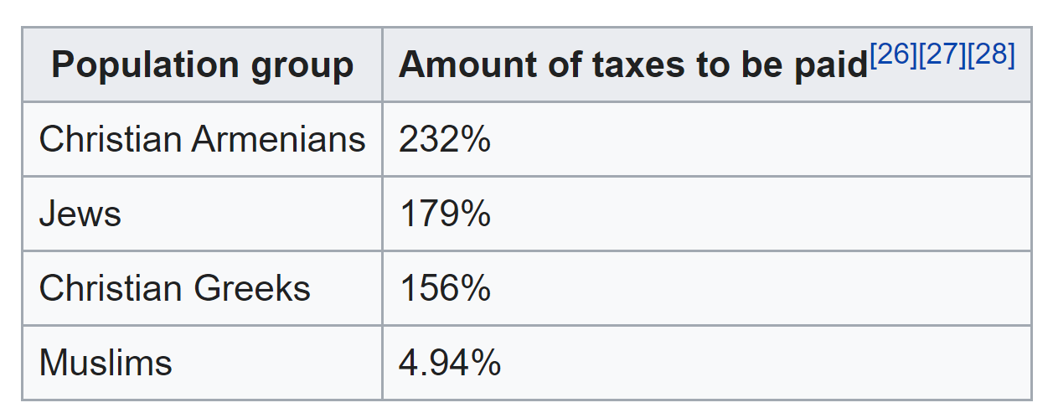
Taxes
https://en.wikipedia.org/wiki/Varl%C4%B1k_Vergisi

Slide 32
6-7 September Events
The Istanbul pogrom, also known as the Istanbul riots or September events, were organized mob attacks directed primarily at Istanbul's Greek minority on 6–7 September 1955.
The events were triggered by the false news that the day before, Greeks had bombed the Turkish consulate in Thessaloniki, in northern Greece—the house where Atatürk had been born in 1881.
A Turkish mafia group, most of whom had been trucked into the city in advance, assaulted Istanbul's Greek community for nine hours. Although the mob did not explicitly call for Greeks to be killed, over a dozen people died during or after the attacks as a result of beatings and arson.
Armenians and Jews were also harmed. The police remained mostly ineffective, and the violence continued until the government declared martial law in İstanbul and called in the army to put down the riots.
The pogrom greatly accelerated emigration of ethnic Greeks from Turkey, and the Istanbul region in particular. The Greek population of Turkey declined from 119,822 in 1927, to about 7,000 in 1978. In Istanbul alone, the Greek population decreased from 116,108 to 49,081 between 1955 and 1960. The 2008 figures released by the Turkish Foreign Ministry placed the number of Turkish citizens of Greek descent at 3,000–4,000; while according to the Human Rights Watch (2006) their number was estimated to be 2,500.

Slide 33
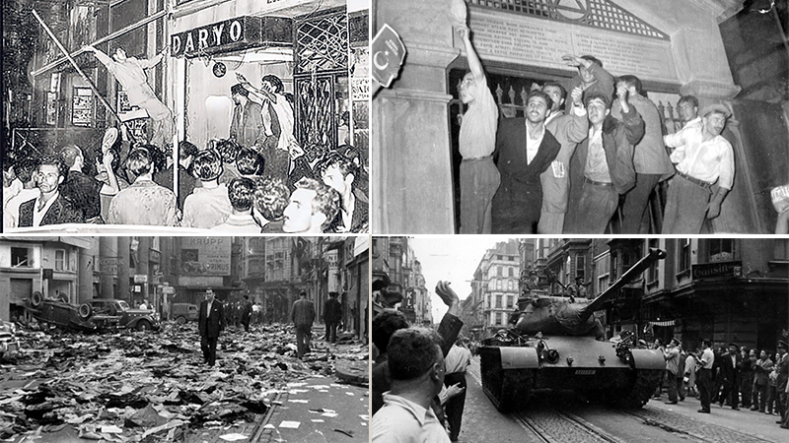
6-7 September Events

Slide 34
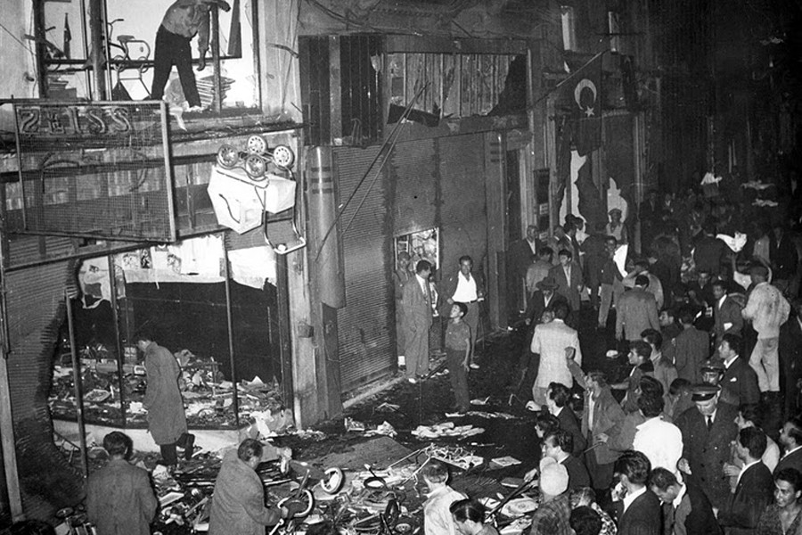
6-7 September Events

Slide 35
20 KGs and 20 Dollars
What if you have an order from government as;
Take 20 kg of personal belongings and leave the country within 12 hours.
In 1964, they gave this order to 13.000 Greeks who lived (were borned) in Istanbul (who had also Greek passports).
But not only 13.000 Greeks, in total 45.000 Greeks deported from their countries.

Slide 36
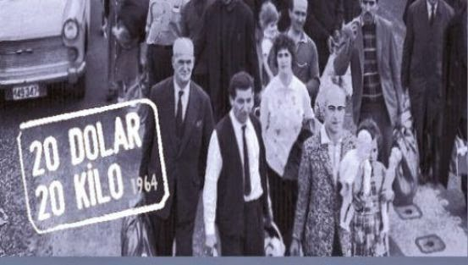
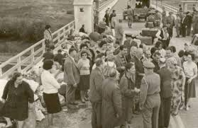
20 KGs & 20 Dollars in 1964

Slide 37
Armenian Properties
The confiscation of Armenian properties by the Ottoman and Turkish governments involved seizure of the assets, properties and land of the country’s Armenian community. Starting with the Hamidian massacres (Adana) in the mid-1890’s and peaking during the Armenian Genocide, the confiscation of the Armenian property lasted continuously until the Istanbul pogrom of 1955 and with renewed efforts in 1974.
https://en.wikipedia.org/wiki/Confiscation_of_Armenian_properties_in_Turkey

Slide 38
A short list of confiscation properties
(with their today’s names)
US Incirlik Air Base
Cankaya Presidential Palace in Ankara
19 properties of Armenian hospital, included a 44,000 sq. m. Land, where had been builted a stadium by municipality
A Cemetary that located on Taksim-Harbiye- Istanbul. Today Hilton Istanbul Hotel, Ceylan Intercontinental Hotel, Taksim Gezi Park are located.
Malatya City Airport’s land (This area belonged to my wife's family.)
Sansarian Building (a tender has occured on Jan 2020 to convert it a luxery hotel)
And many more, we can not count here…

Slide 39
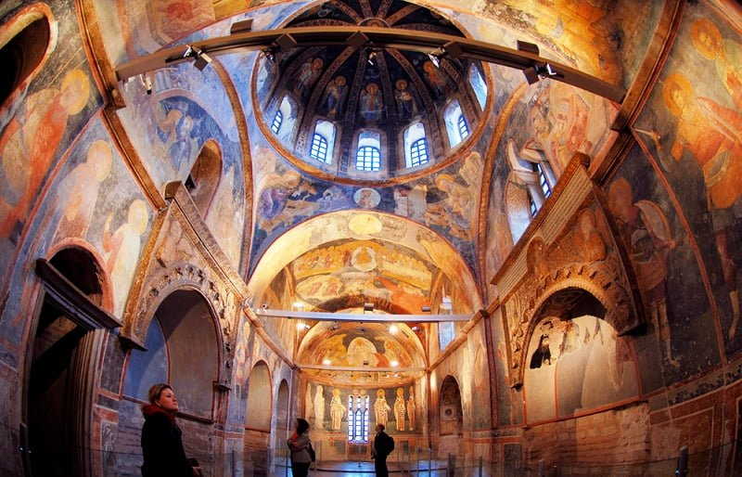
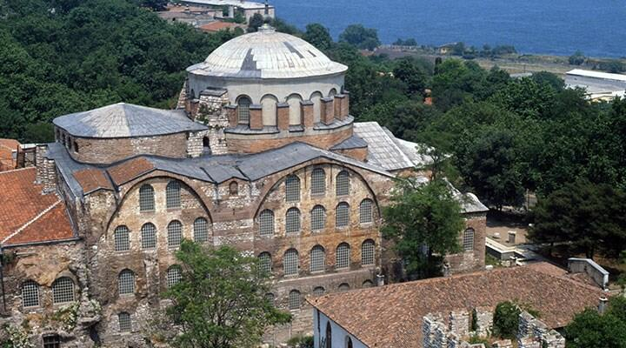
Churches to Mosques
Newest converted one not Hagia Sophia anymore the newest one is Kariye (Chora) Museum, former Church became a Mosque.
For more information please check Hagia Sophia Presentation.

Slide 40
What is more…
Neither confiscations nor convertion to mosque, a huge amount of Christian’s properties were damaged. Some churches are still used as barn.
The properties that are still alive today are exposed to a danger of weasel renovations.

Slide 41
Unfortunately, there is no good stories about Turkish Christians, but according to Lausanne Peace Agreement, Switzerland, on 30 January 1923, Christian minorities have some rights as;
  Mother language education
  Praying rights such as, weddings, funeral, baptism
  However, this human rights are not economically supported by government.
Let’s take a look a few more pictures…

Slide 42
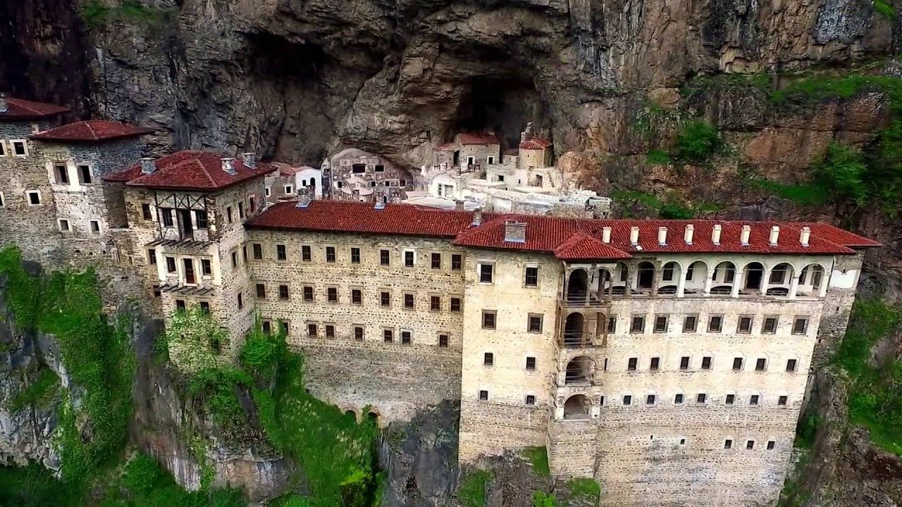
Sumela Greek Orthodox Monastery – Trabzon
(North Eastern Turkey near Black Sea)

Slide 43
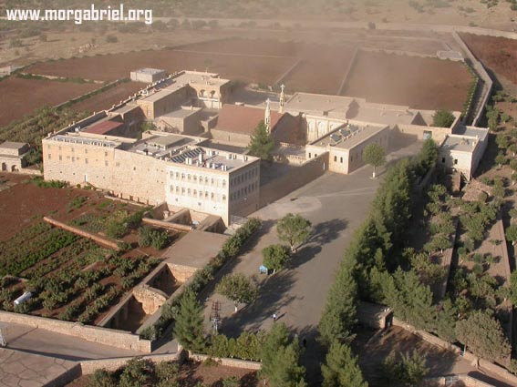
Monastery of Mor Gabriel (Syriac)- Mardin (South East Turkey near Syria Border)

Slide 44
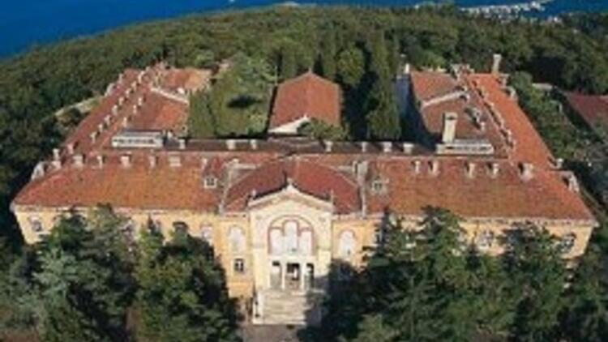
Halki Seminary – Former Greek Religious School - Istanbul Prince Islands

Slide 45
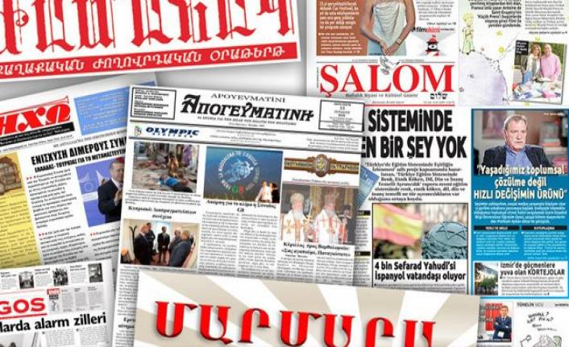
Some minority newspapers
(Salom belongs to Jewish community)

Slide 46
References
https://en.wikipedia.org/wiki/Christianity_in_Turkey
https://en.wikipedia.org/wiki/Christianity_in_Turkey#List_of_church_buildings_in_Turkey
http://www.turkiyeermenileripatrikligi.org/
https://en.wikipedia.org/wiki/Varl%C4%B1k_Vergisi
https://www.hurriyetdailynews.com/turkey-converts-kariye-museum-into-mosque-157585
https://en.wikipedia.org/wiki/Cappadocia
https://en.wikipedia.org/wiki/Istanbul_pogrom
https://en.wikipedia.org/wiki/Armenian_Genocide
https://theconversation.com/christians-have-lived-in-turkey-for-two-millennia-but-their-future-is-uncertain-127296
https://www.bestofephesus.com/christianity-in-turkey.php

Slide 47
Thank You
By OP

